Slide 1
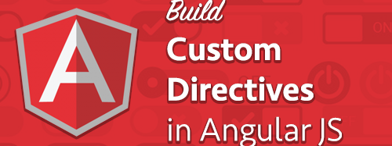
AngularJS
Custom directives

Slide 2
What are Directives?
Directives are markers on a DOM element (such as an attribute, element name, comment or CSS class)
They tell AngularJS's HTML compiler to attach a specified behavior to that DOM element or even to transform the DOM element and its children.
What does it mean to "compile" an HTML template? For AngularJS, "compilation" means attaching directives to the HTML to make it interactive. The reason we use the term "compile" is that the recursive process of attaching directives mirrors the process of compiling source code in compiled programming languages.

Slide 3
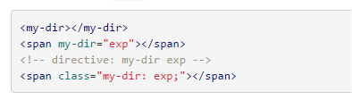
Directive types
$compile can match directives based on element names, attributes, class names, as well as comments.
Best Practice: Prefer using directives via tag name and attributes over comment and class names

Slide 4
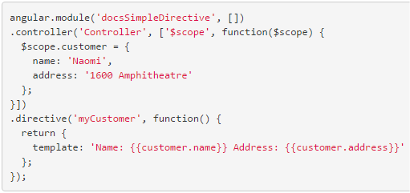


Creating a Template-expanding directive (inline)
To register a directive, you use the module.directive API
index.html
script.js
result

Slide 5
Notes on directives names
In order to avoid collisions it's best to prefix your own directive names.
But... do not prefix your own directives with ng or they might conflict with directives included in a future version of Angular.
Directives (and attributes) must use:
lowerCamelCase in Javascript files
Kebab-case in html files

Slide 6
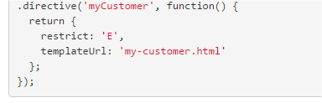

Directive type restriction
The restrict option is typically set to:
'A' - only matches attribute name
'E' - only matches element name
'C' - only matches class name
'M' - only matches comment
These restrictions can all be combined :
'AEC' - matches either attribute or element or class name
index.html
script.js

Slide 7
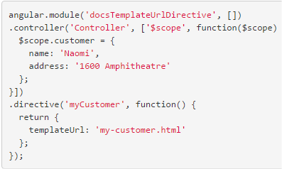


Template-expanding directive (external file)
Best Practice: Unless your template is very small, it's typically better to break it apart into its own HTML file and load it with the templateUrl option.
index.html
script.js
my-customer.html

Slide 8
Isolating scope
Our myCustomer directive above is great, but it has a fatal flaw.
We can only use it once within a given scope.
index.html
script.js

Slide 9
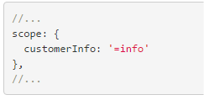
Isolating scope
What we want:
A separate scope inside the directive
A binding from the outer scope the a directive's inner scope
The solution: the scope option
The scope option is an object that contains a property for each isolate scope
Its name (customerInfo) corresponds to the directive's isolate scope property customerInfo.
Its value (=info) tells $compile to bind to the info attribute.
Note: Attributes in the scope option of directives are normalized, To bind to the attribute in <div bind-to-this="thing">, you'd specify a binding of =bindToThis.

Slide 10
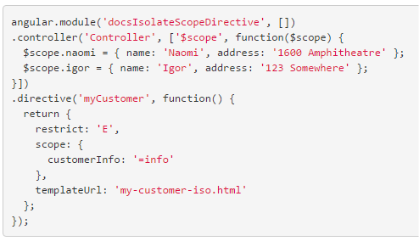
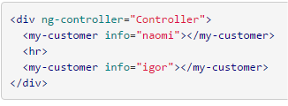

Isolating scope
index.html
script.js
my-customer-iso.html
result

Slide 11
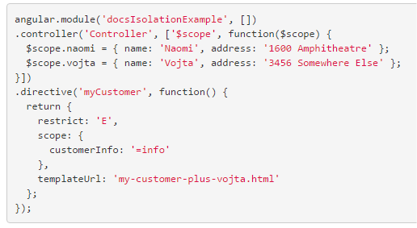


Isolating scope
The isolate scope of the directive isolates everything except models that you've explicitly added to the scope: {} object
index.html
script.js
my-customer-plus-vojta.html
Nothing displayed as vojta is not defined in the directive nor inherited from the controller scope

Slide 12
Creating a Directive that Manipulates the DOM
Directives that want to modify the DOM use the link option.
link takes a function with the following signature:
function link(scope, element, attrs, controller, transcludeFn) { ... }
scope is an Angular scope object.
element is the jqLite-wrapped element that this directive matches.
attrs is a hash object with key-value pairs of normalized attribute names and their corresponding attribute values.
controller is the directive's required controller instance(s) or its own controller (if any). The exact value depends on the directive's require property.
transcludeFn is a transclude linking function pre-bound to the correct transclusion scope.

Slide 13
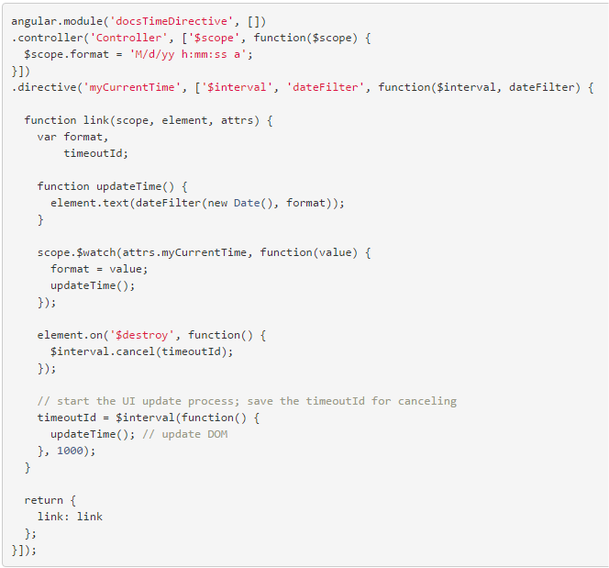


Creating a Directive that Manipulates the DOM
index.html
result
script.js

Slide 14
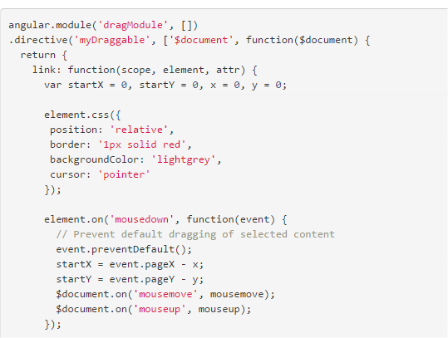

Creating a Directive that Adds Event Listeners
script.js
index.html

Slide 15
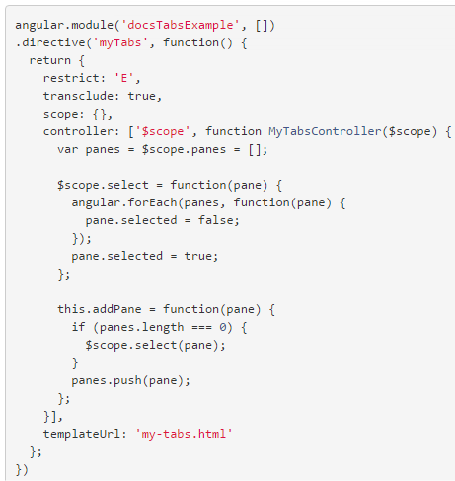
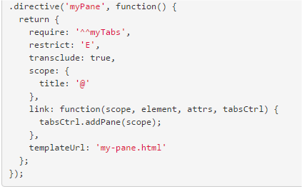
Creating Directives that Communicate
script.js

Slide 16
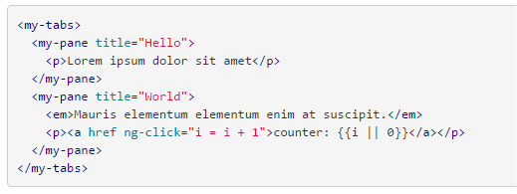
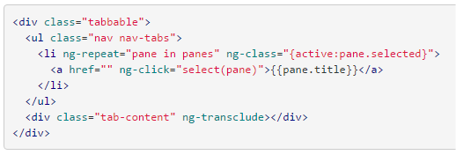
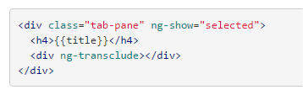
Creating Directives that Communicate
index.html
my-tabs.html
my-pane.html

Slide 17
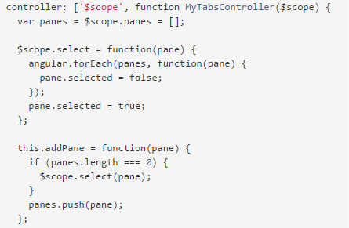
Creating Directives that Communicate
The myPane directive has a require option with value ^^myTabs.
$compile will throw an error unless the specified controller is found
^^ prefix: this directive searches for the controller on its parents.
^ prefix: the directive look for the controller on its own element or its parents
without any prefix: the directive would look on its own eement only
myTabs directive use a custom controller!

Slide 18
Creating Directives that Communicate
The myPane directive has a require option with value ^^myTabs.
$compile will throw an error unless the specified controller is found
^^ prefix: this directive searches for the controller on its parents.
^ prefix: the directive look for the controller on its own element or its parents
without any prefix: the directive would look on its own eement only
myTabs directive use a custom controller!

